Slide 1
Cryptography and Network Security
Services, Mechanisms & Attacks

Slide 2
Session Meta Data
Author | Dr T Sree Sharmila
Reviewer
Version Number | 1.0
Release Date | 25 June 2018

Slide 3
Revision History
Revision Date | Details | Version no.
 |  | 1.0

Slide 4
Agenda
Learning objectives
OSI Security architecture
Services, mechanisms, attacks
Security services
Security mechanisms
Security attacks
Summary
Test your understanding
References

Slide 5
Learning objectives
Describe the key security requirements of confidentiality, integrity, and availability
Describe X.800 security architecture for OSI
Discuss the types of security threats and attacks

Slide 6
Agenda
OSI Security architecture
Services, mechanisms, attacks
Security services
Security mechanisms
Security attacks
Summary
Test your understanding
References

Slide 7
OSI Security Architecture
ITU-T (International Telecom Union – Telecom Standardization Sector recommends X.800Security Architecture for OSI, defines a systematic approach.
This is useful for managers to organize the task of providing security.
This focuses on security services, mechanisms and attacks.

Slide 8
Agenda
OSI Security architecture
Services, mechanisms, attacks
Security services
Security mechanisms
Security attacks
Summary
Test your understanding
References

Slide 9
Services, Mechanisms, Attacks
need systematic way to define requirements
consider three aspects of information security:
security attack
security mechanism
security service
consider in reverse order

Slide 10
Security Service
is something that enhances the security of the data processing systems and the information transfers of an organization
intended to counter security attacks
make use of one or more security mechanisms to provide the service
replicate functions normally associated with physical documents
eg have signatures, dates; need protection from disclosure, tampering, or destruction; be notarized or witnessed; be recorded or licensed

Slide 11
Security Mechanism
a mechanism that is designed to detect, prevent, or recover from a security attack
no single mechanism that will support all functions required
however one particular element underlies many of the security mechanisms in use: cryptographic techniques
Notes:
Cryptography is a foundation to support all the functions.
Technically the most difficult part.

Slide 12
Security Attack
any action that compromises the security of information owned by an organization
information security is about how to prevent attacks, or failing that, to detect attacks on information-based systems
have a wide range of attacks
can focus of generic types of attacks
note: often threat & attack mean same

Slide 13
Agenda
OSI Security architecture
Services, mechanisms, attacks
Security services
Security mechanisms
Security attacks
Summary
Test your understanding
References

Slide 14
Security Services
X.800 defines it as: a service provided by a protocol layer of communicating open systems, which ensures adequate security of the systems or of data transfers
RFC 2828 defines it as: a processing or communication service provided by a system to give a specific kind of protection to system resources
X.800 defines it in 5 major categories

Slide 15
Security Services (X.800)
Authentication - assurance that the communicating entity is the one claimed
Access Control - prevention of the unauthorized use of a resource
Data Confidentiality –protection of data from unauthorized disclosure
Data Integrity - assurance that data received is as sent by an authorized entity
Non-Repudiation - protection against denial by one of the parties in a communication
Notes:
See Table 1.4 for details of the 5 Security Service categories and the 14 specific services.

Slide 16
Agenda
OSI Security architecture
Services, mechanisms, attacks
Security services
Security mechanisms
Security attacks
Summary
Test your understanding
References

Slide 17
Security Mechanisms (X.800)
specific security mechanisms:
encipherment, digital signatures, access controls, data integrity, authentication exchange, traffic padding, routing control, notarization
pervasive security mechanisms:
trusted functionality, security labels, event detection, security audit trails, security recovery
Notes:
Specific: may be incorporated into the appropriate protocol layer
pervasive: not specific to any particular OSI security service or protocol layer
see Table 1.5 for details of these mechanisms, and Table 1.6 for the relationship between services and mechanisms.
The “specific security mechanisms” are protocol layer specific, whilst the “pervasive security mechanisms” are not.
Will meet some of these mechanisms in much greater detail later.

Slide 18
Agenda
OSI Security architecture
Services, mechanisms, attacks
Security services
Security mechanisms
Security attacks
Summary
Test your understanding
References

Slide 19
Classify Security Attacks as
passive attacks - eavesdropping on, or monitoring of, transmissions to:
obtain message contents, or
monitor traffic flows
active attacks – modification of data stream to:
masquerade of one entity as some other
replay previous messages
modify messages in transit
denial of service

Slide 20
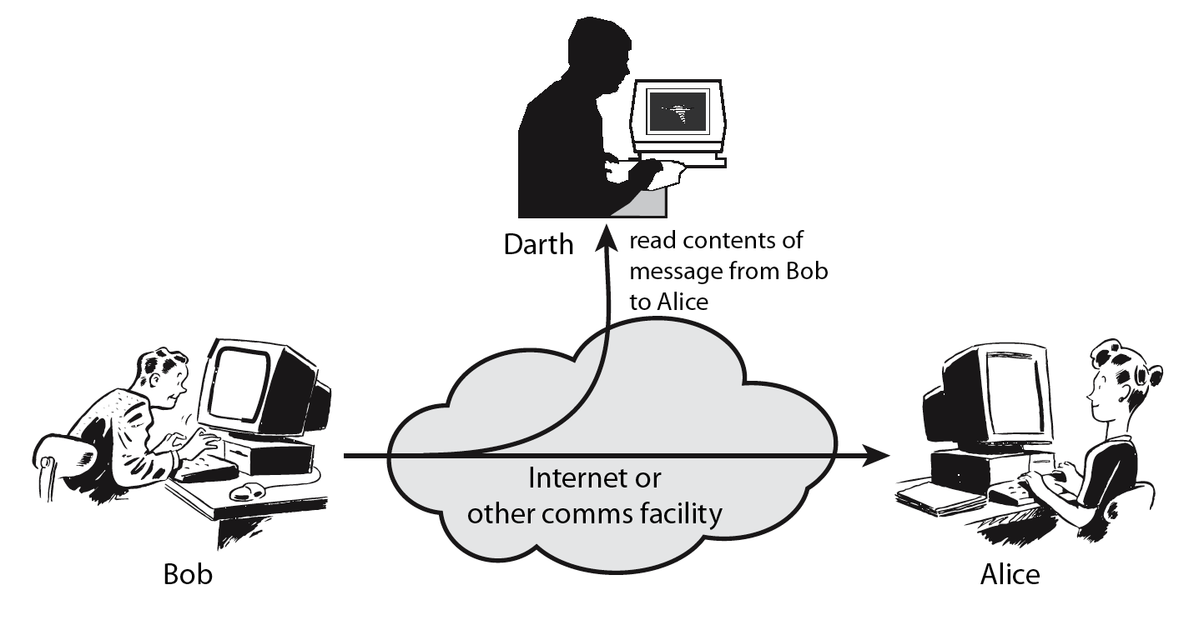
Passive Attacks
Reading contents of messages
Also called eavesdropping
Difficult to detect passive attacks
Defense: to prevent their success
20
Notes:
20

Slide 21
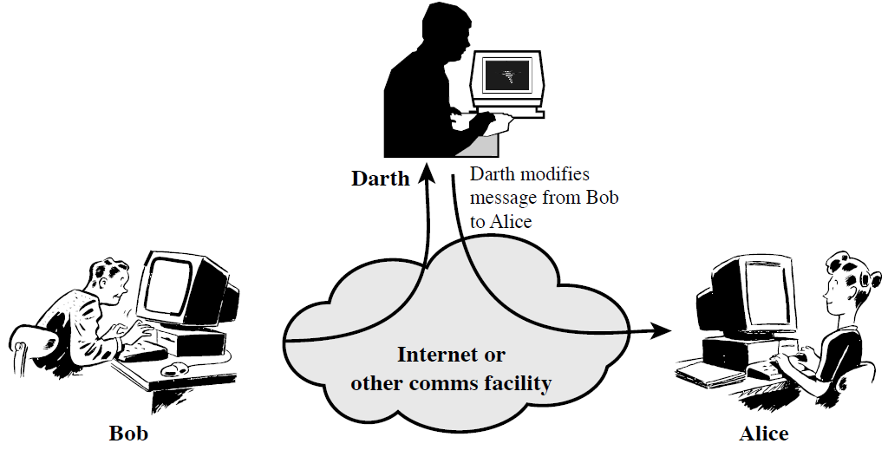
Active Attacks
Modification or creation of messages (by attackers)
Four categories: modification of messages, replay, masquerade, denial of service
Easy to detect but difficult to prevent
Defense: detect attacks and recover from damages
21

Slide 22
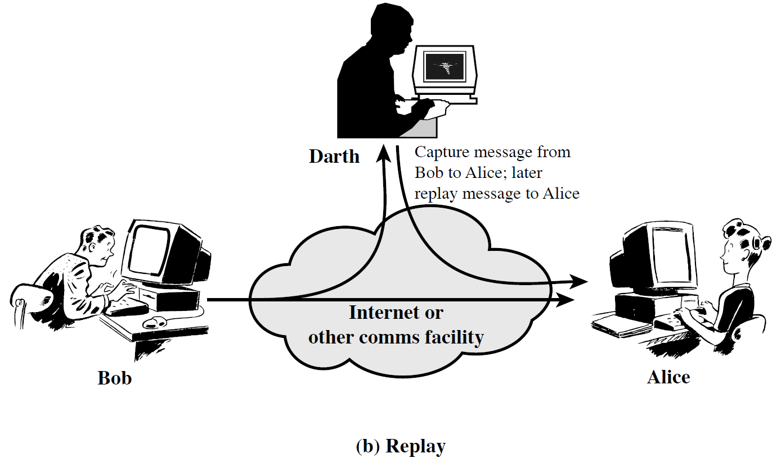
Replay
22

Slide 23

Masquerade
23

Slide 24
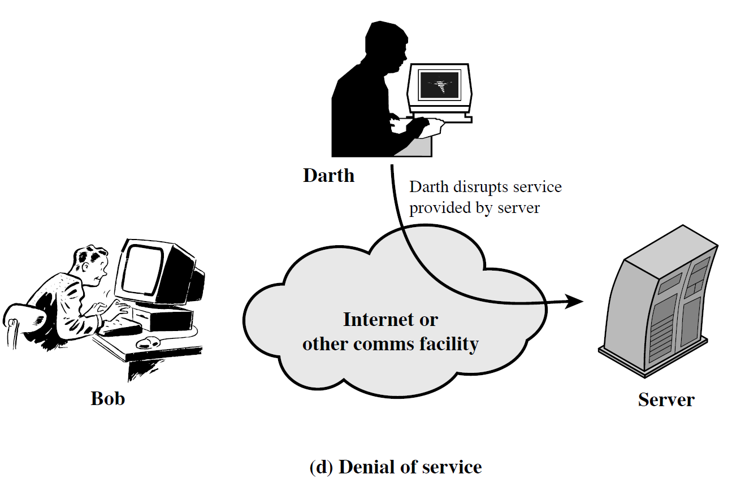
Denial of service
24

Slide 25
Summary
Studied the key security requirements
Discussed X.800 security architecture
Discuss security services, mechanisms and attacks

Slide 26
Test your understanding
What is the OSI security architecture?
List and briefly define the categories of passive and active attacks.
Consider the following and define the type of security attack:
Albert gives a cheque of Rs.50,00/- to the shopkeeper to buy a book. Later he finds that the cheque was cashed for Rs.50,000/-
A student breaks into university examination office to get a copy of exam paper to be held on the next day.
A person sends hundreds of emails everyday to another person using a phony return email address.

Slide 27
References
1. William Stallings, Cryptography and Network Security, 6th Edition, Pearson Education, March 2013.
2. Charlie Kaufman, Radia Perlman and Mike Speciner, “Network Security”, Prentice Hall of India, 2002.

